Slide 1
ASSIGNMENT 1: ROV (Remote Operated Vehicle)
ROBOTIC HARDWARE (MCTE 4396)
Lecturer: DR. ZULKIFLI BIN ZAINAL ABIDIN
Slide by: NAUFAL BIN MUHAMMAD LOFTY (1911889)

Slide 2
HISTORY OF ROV

Slide 3
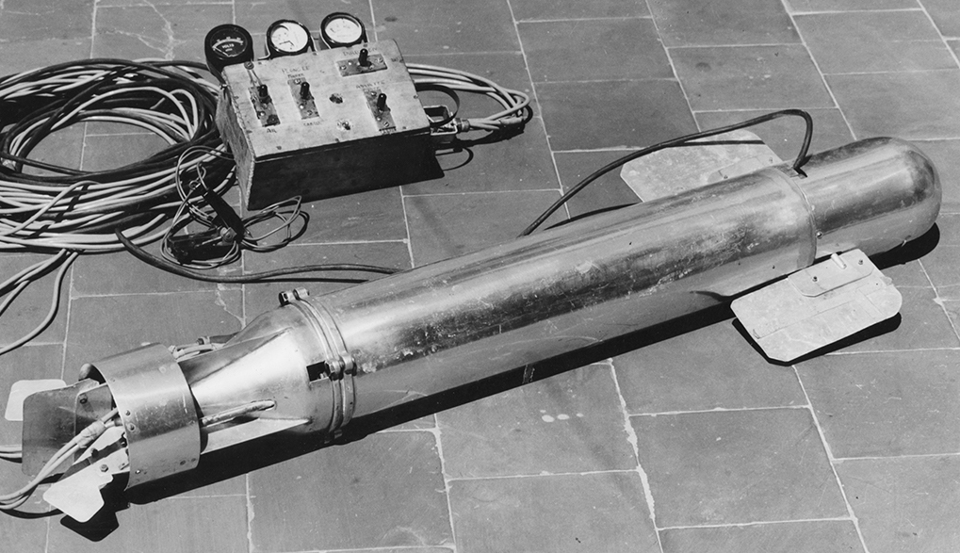
The First Ever ROV
The first ever ROV made in 1953 by Dimitri Rebikoff
Used for underwater exploration, research, and maintenance of the underwater structure.
Connected by long umbilical cord for communication and power supply transfer.
Equipped with cameras and light for underwater operation.
The Poodle

Slide 4
History of ROV
1960s | Industrial grade ROV, Mantis is introduced Developed for the oil and gas industry by Westinghouse
1970s | Upgrade the functionality of the ROVs for underwater construction and maintenance. Other functions are added such as color cameras, manipulator arms, and sonar systems.
1980s | Evolved for heavy duty tasks. More usage for the oil and gas industry. Widespread functionality of exploration, inspection, maintenance, and repair of subsea construction.
1990s | Limitations are upgraded to explore the higher depth of the sea. Added control systems, better sensors, and data processing.

Slide 5
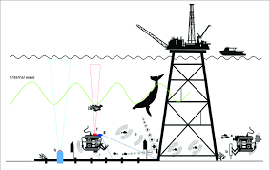
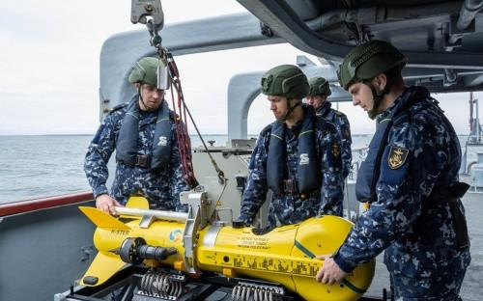
Applications
Offshore Energy (Oil & Gas, Hydroelectric)
General Visual Inspection
Infrastructure Deployment and Recovery
Close Visual Inspections ( Study the underwater infrastructure closely)
Control Manifold Interventions
Military
Special Recovery Operations
Waterborne Improvised Explosive Device (WIED) Intervention
Submarine Rescue
Hydrography
Sea and Limpet Mine Intervention

Slide 6
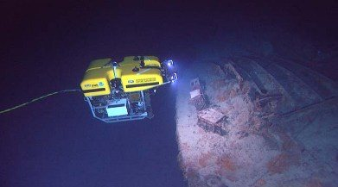
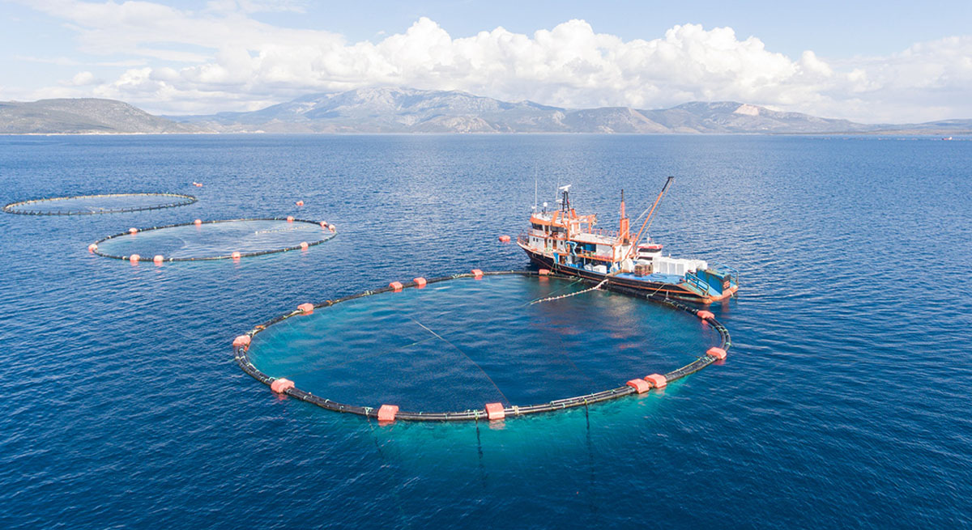
Underwater Exploration
Sample collection and data processing
Monitor the underwater environment
Search and rescue mission
Marine life research
Aquaculture
Aqua life monitoring and inspection
Cleaning and management of aquariums
Wildlife documentation
Water inspection

Slide 7
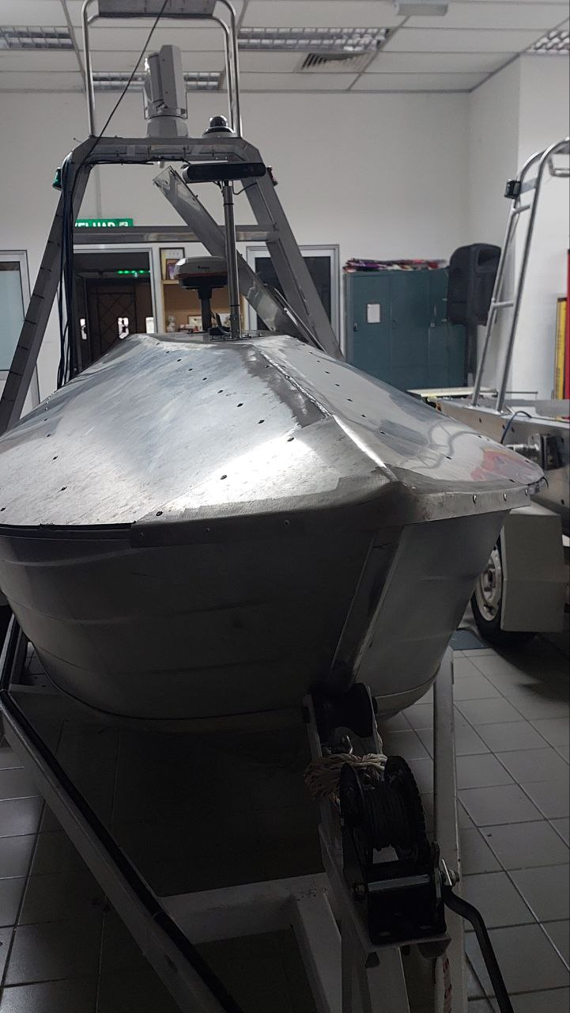
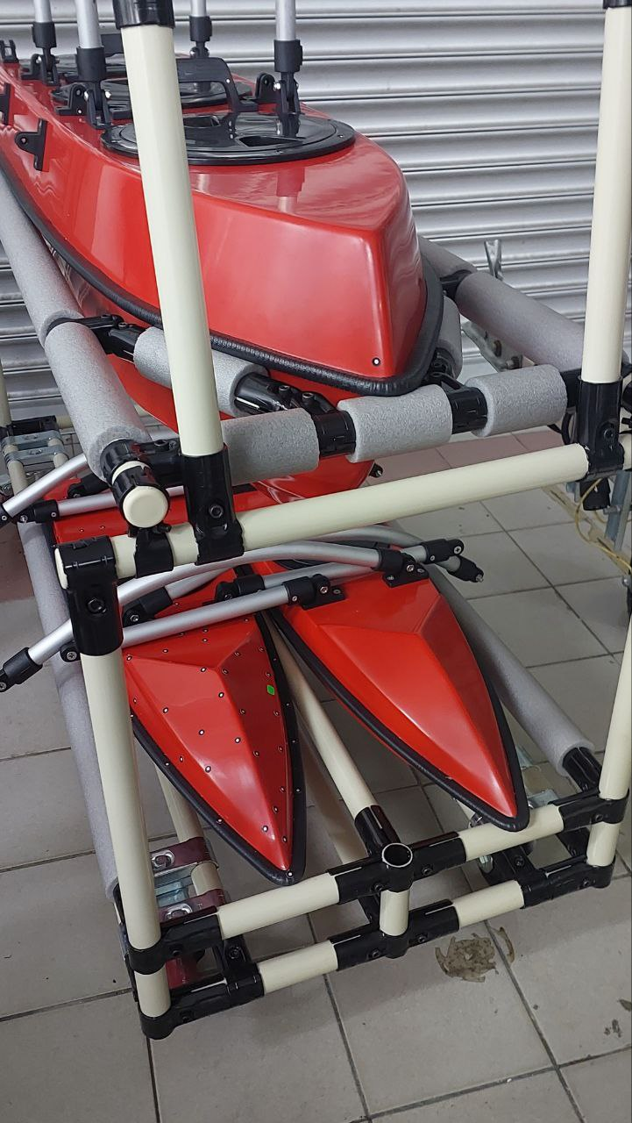
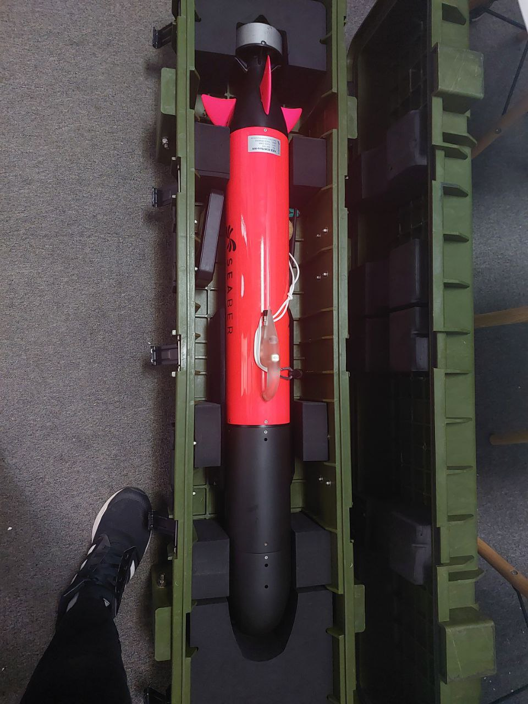
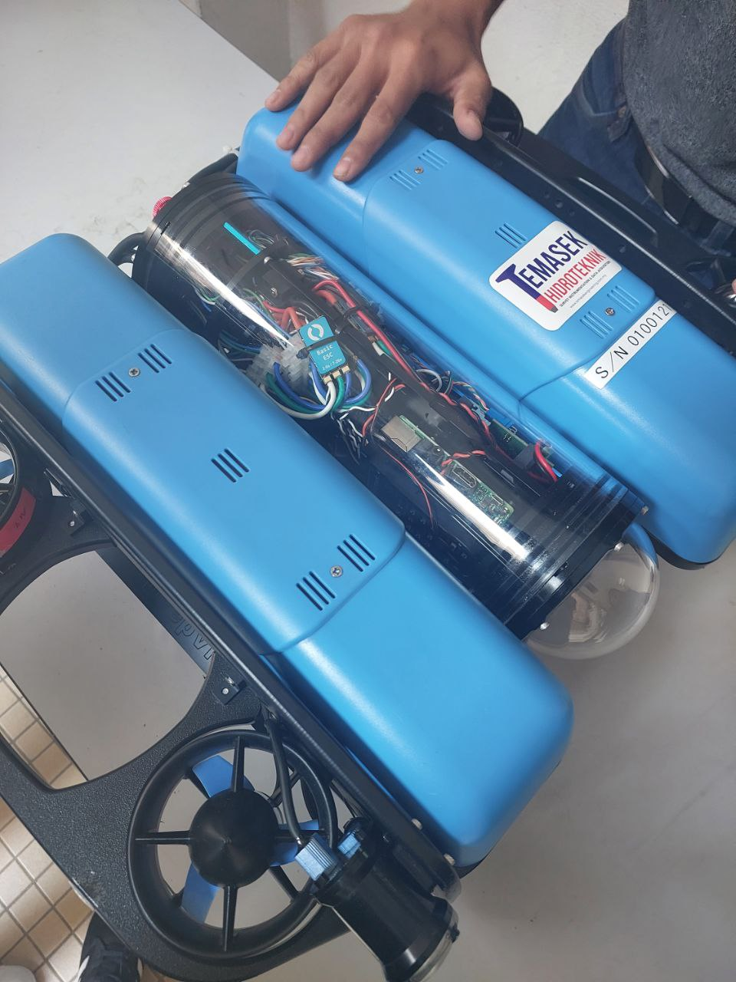
Hull Design
Mono Hull
Katamaran
Triple Katamaran
Torpedo Hull

Slide 8
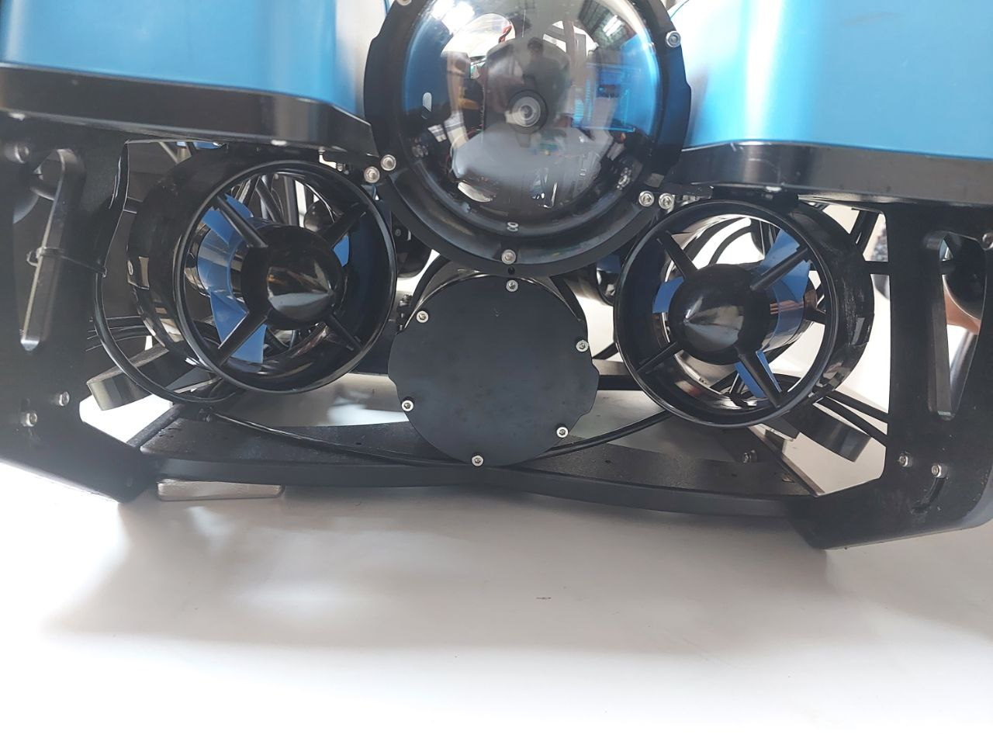
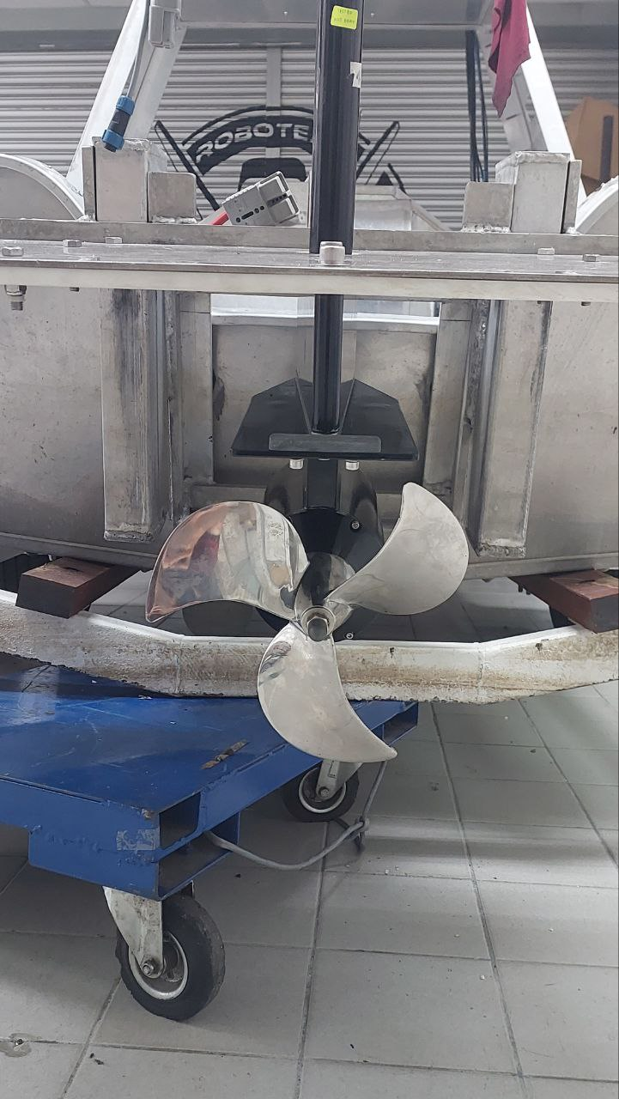
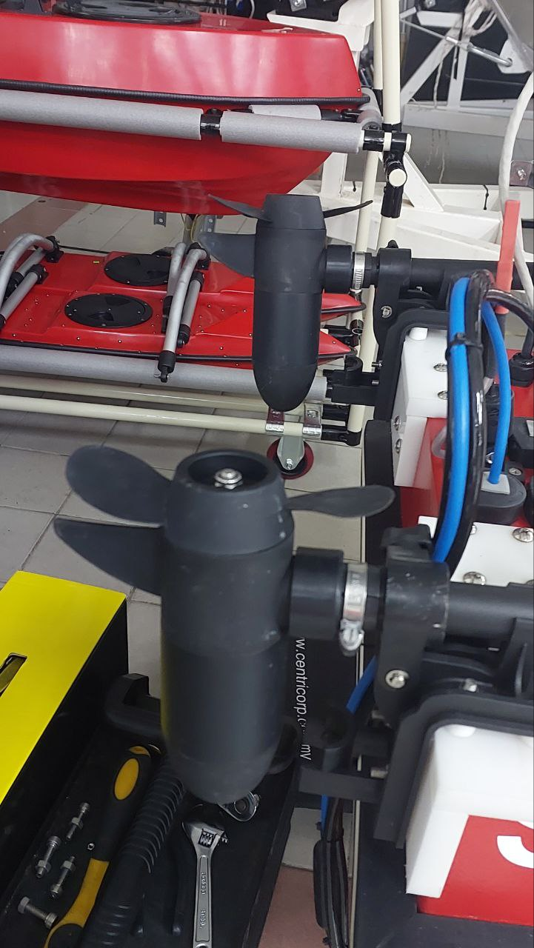
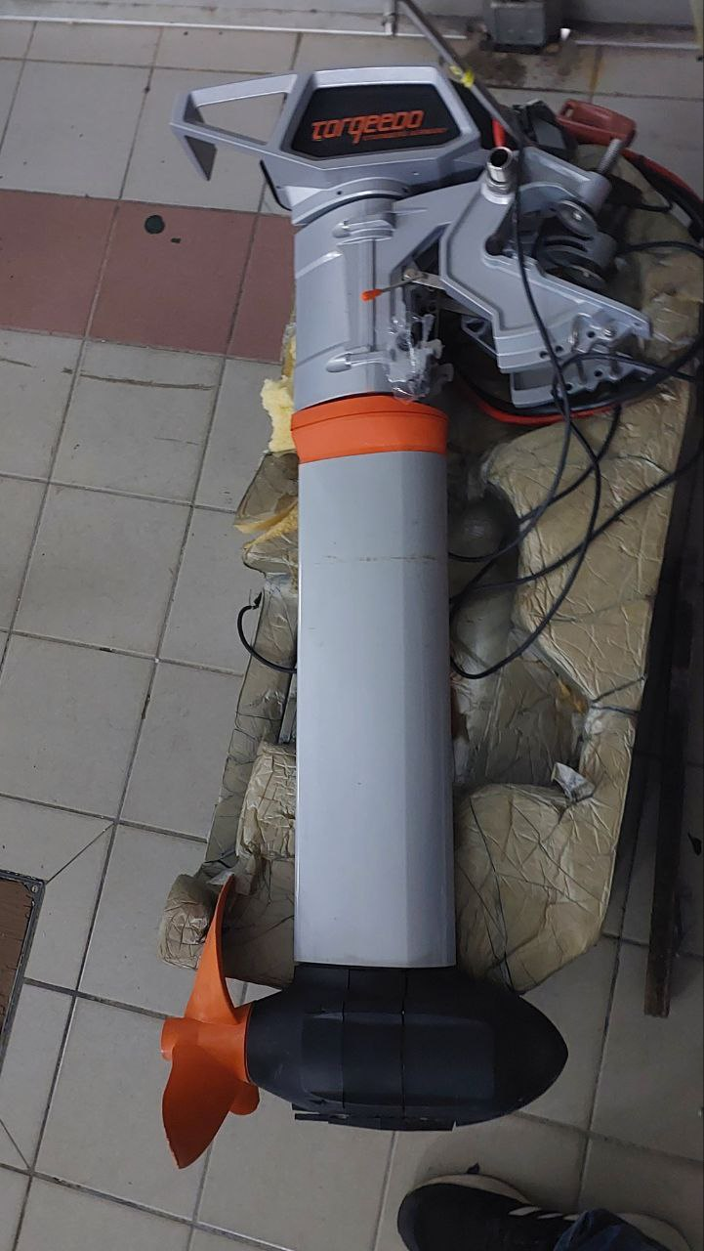
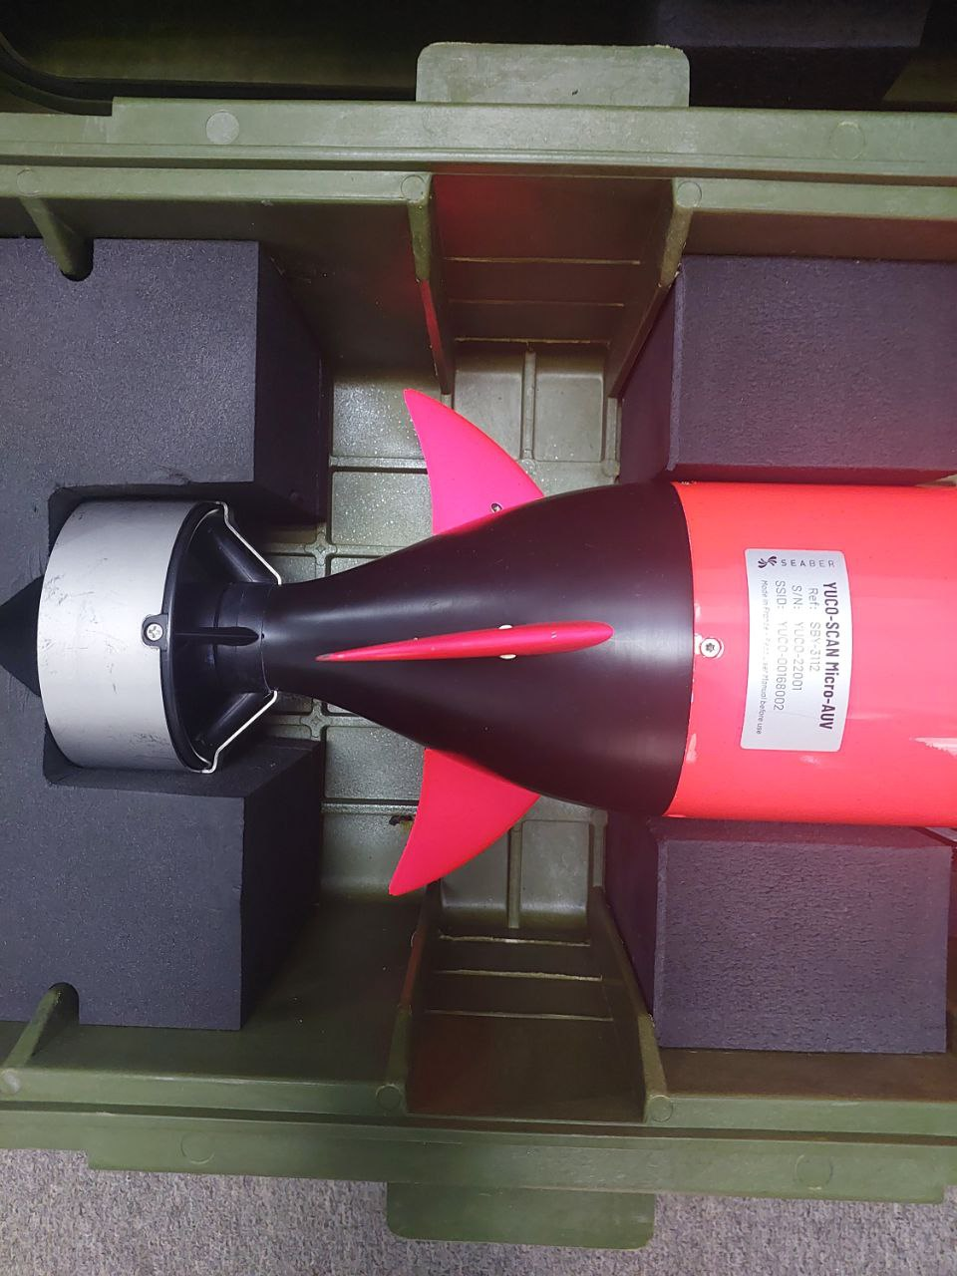
Propulsion System
Thrusters
Thrusters
Propeller
Motor Boat

Slide 9
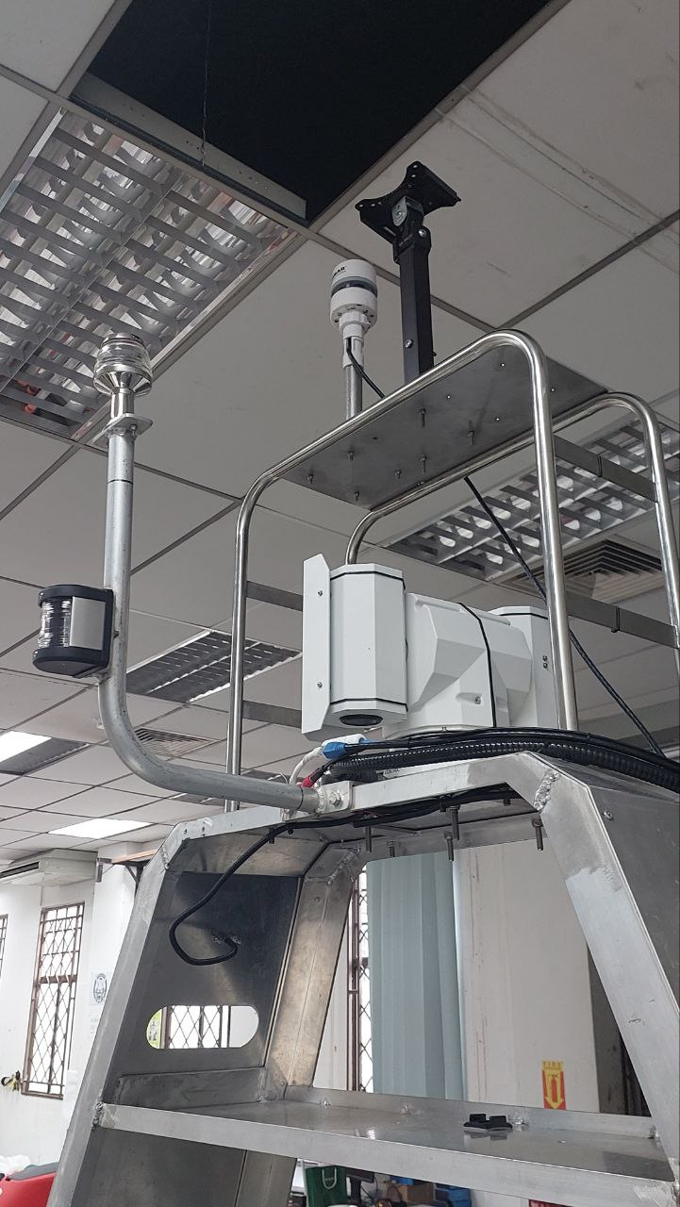
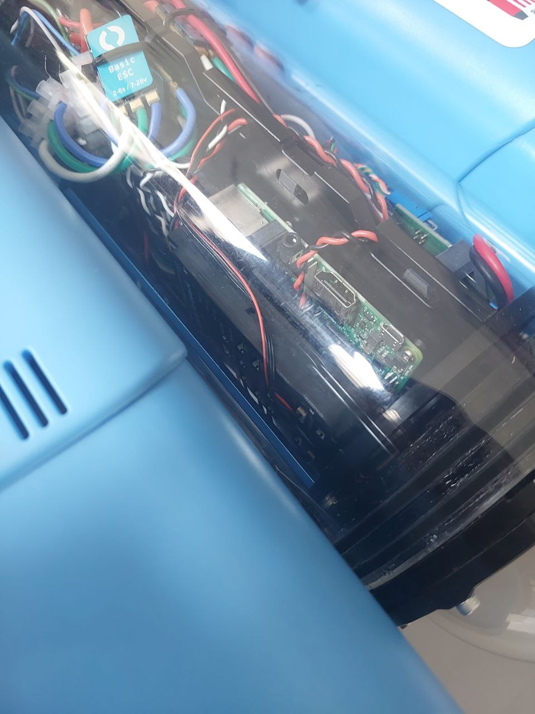
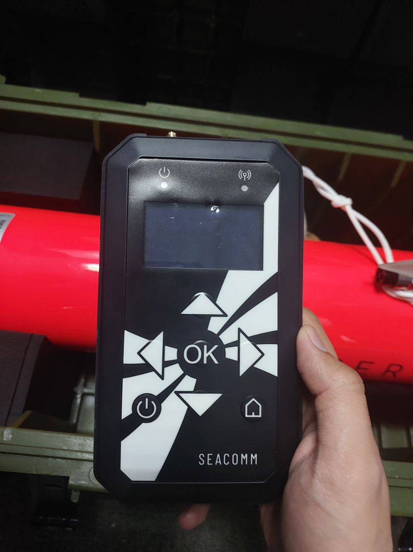
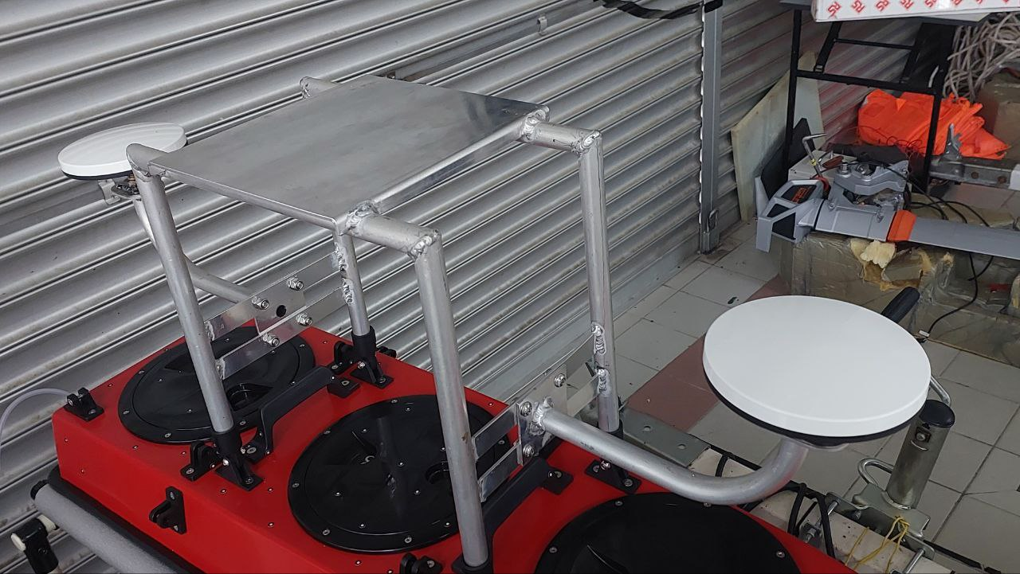
Navigation System & Control
GPS Sensor
IMU Sensor and remote control
IMU Sensor
GPS Sensor Front and Back

Slide 10
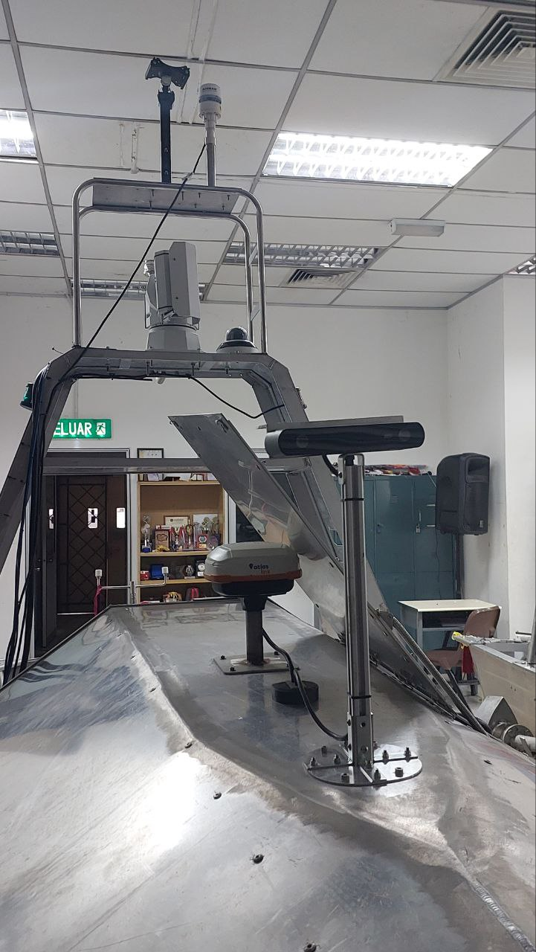
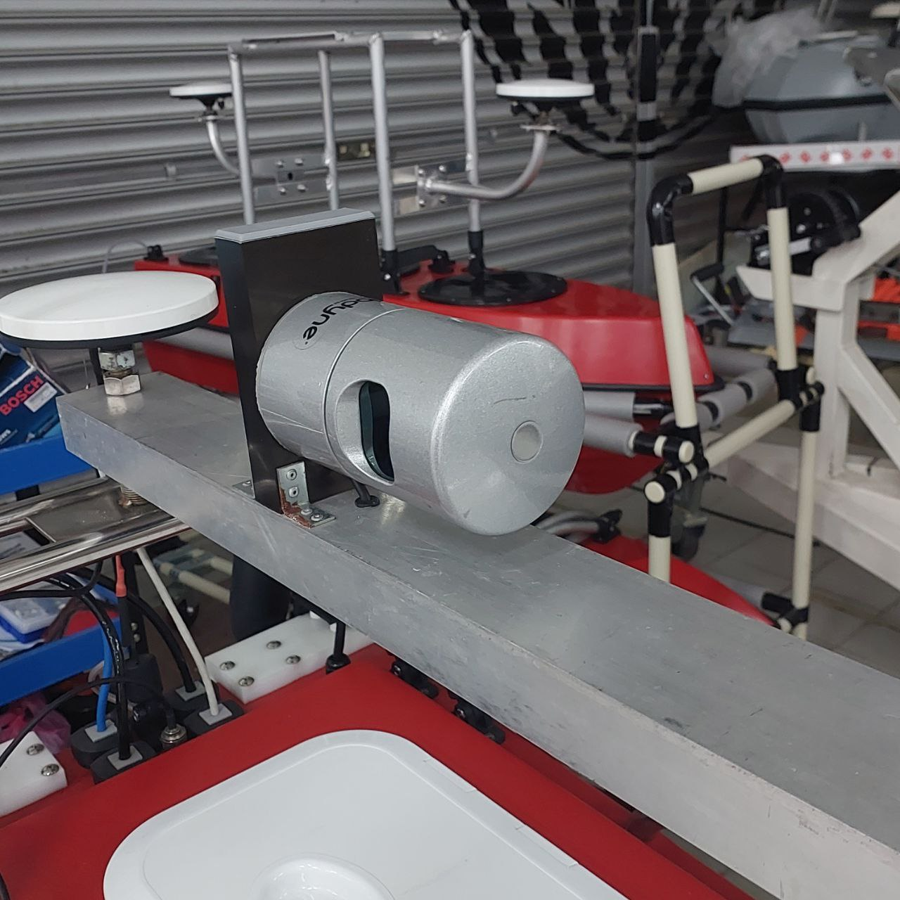
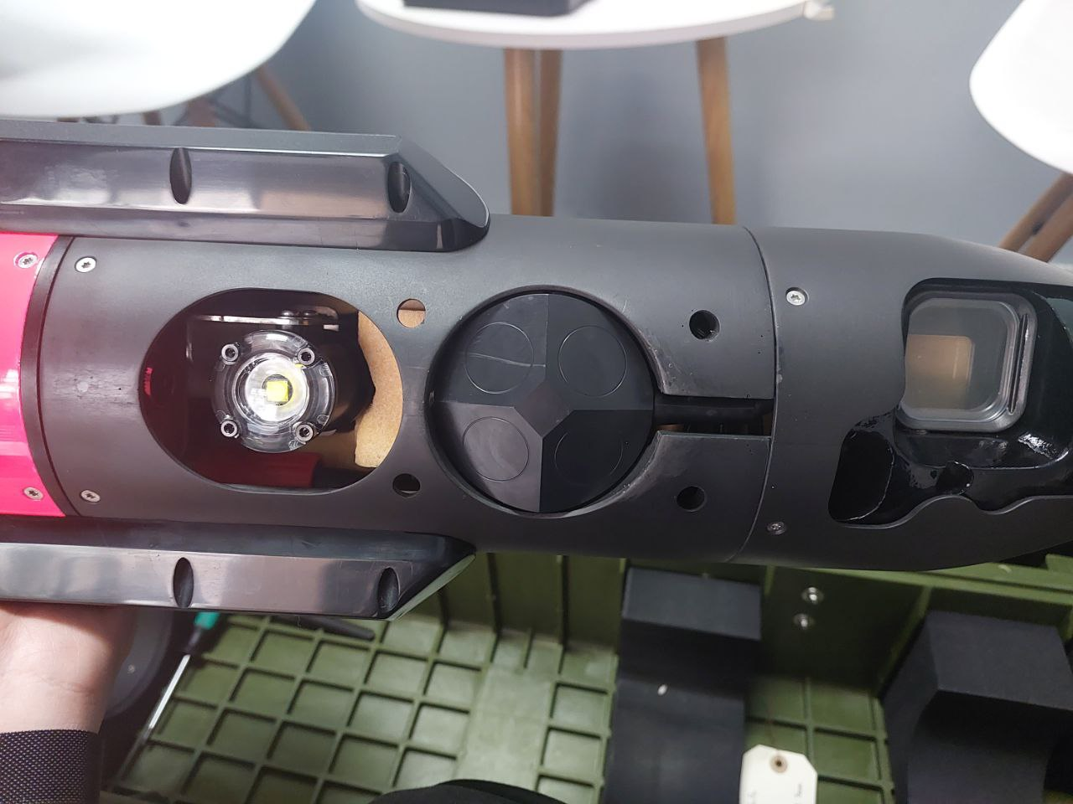
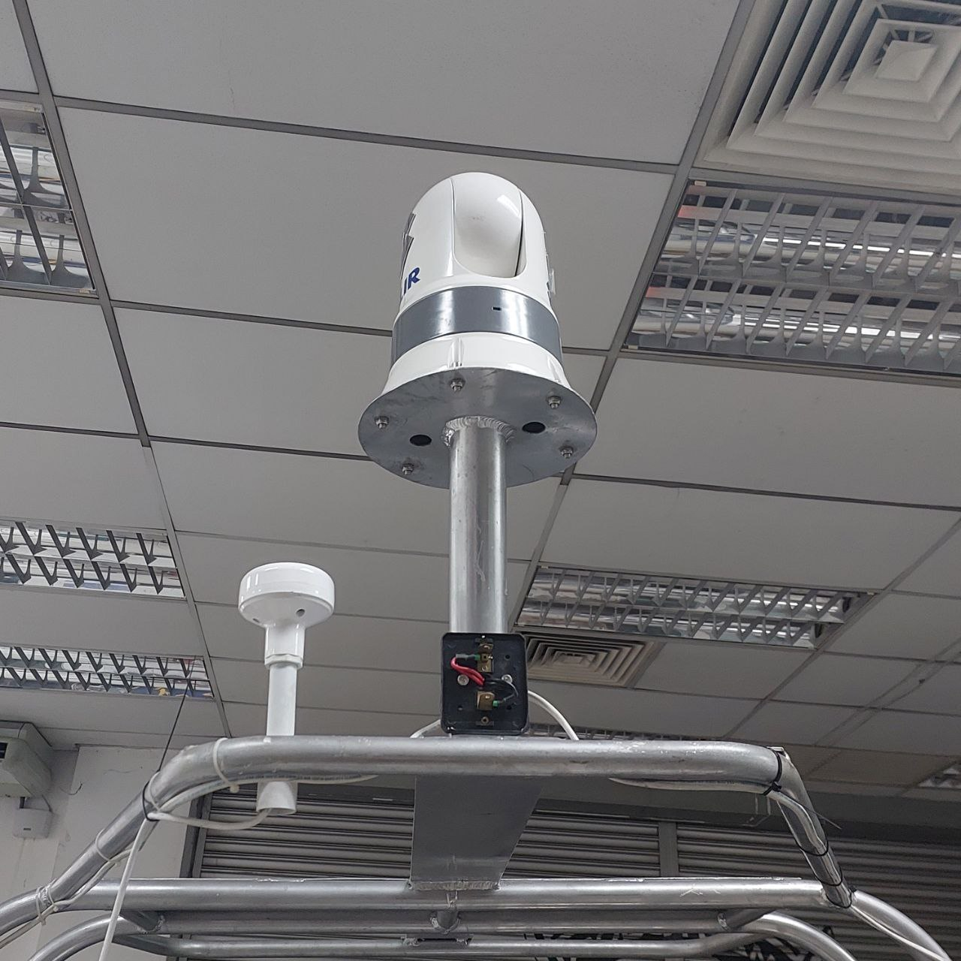
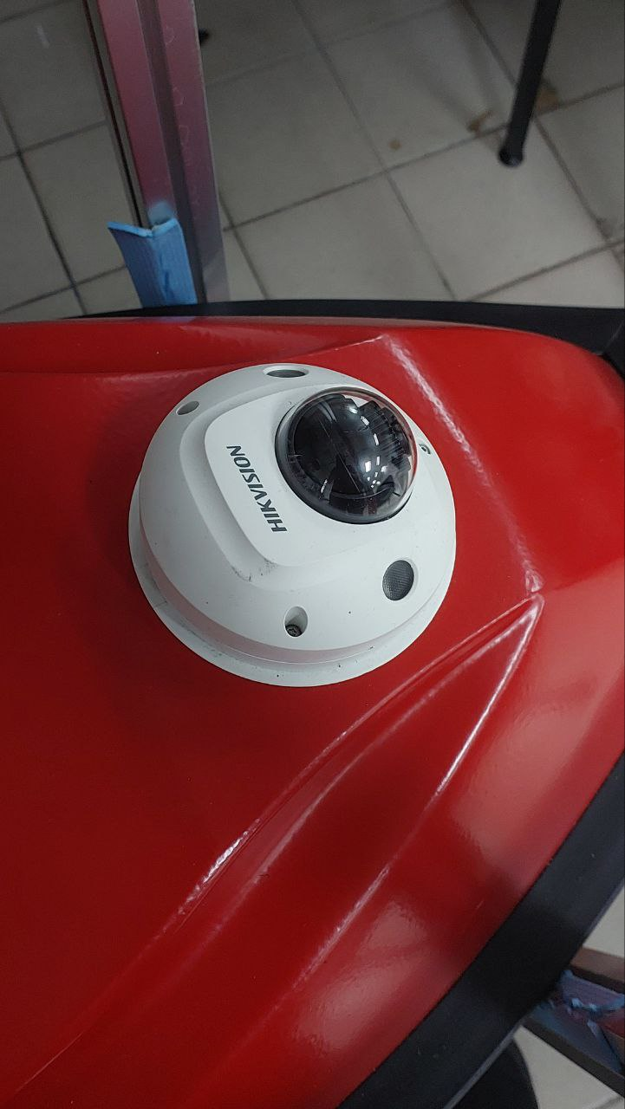
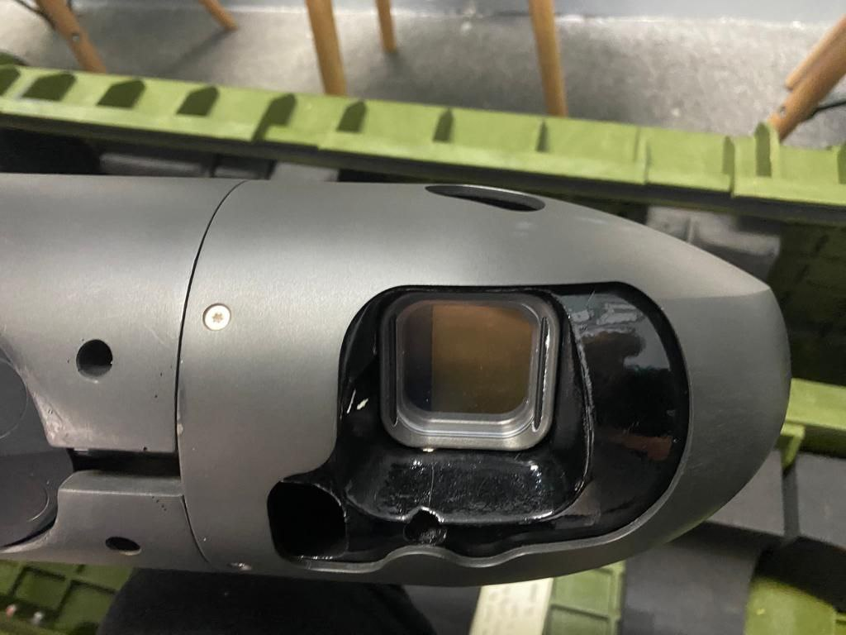
Data Collection
RGBD camera, weather monitoring system
Camera Sensor and depth sensor
360 Camera and velodyne LiDAR for mapping
Camera Sensor, IMU, depth sensor

Slide 11
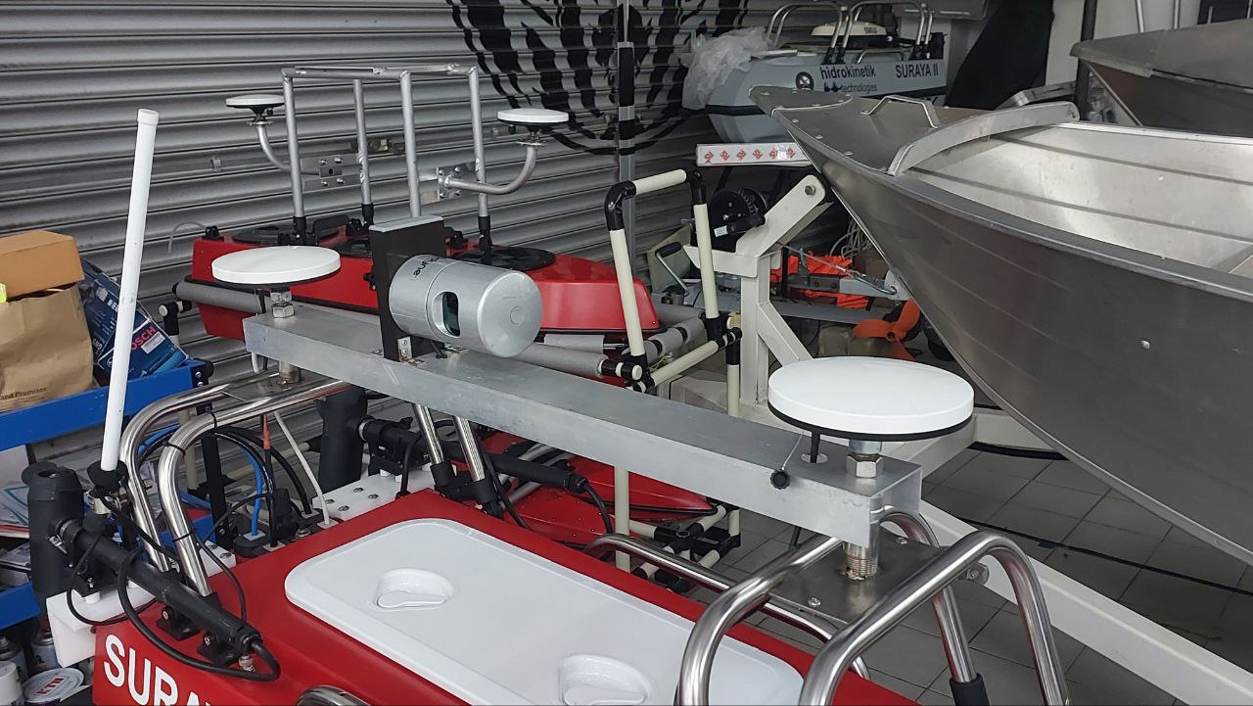
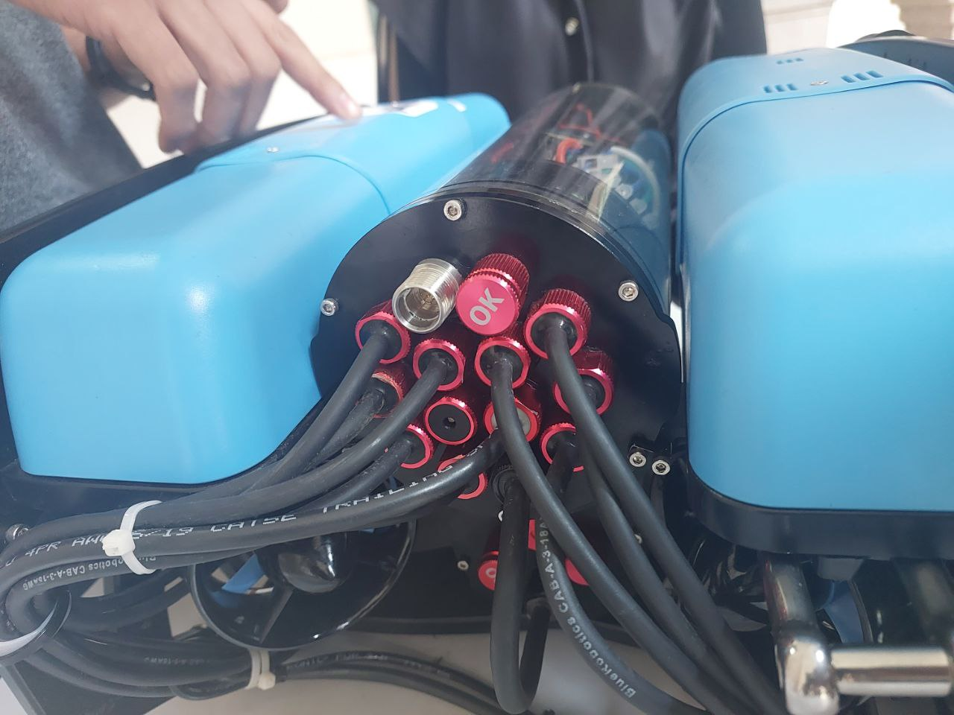
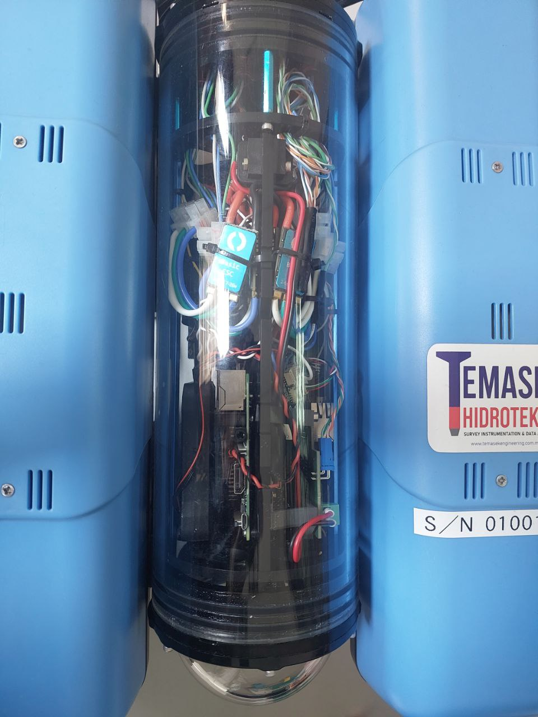
Data Transmission
Radio Transceiver
Wired Data Transmission
GPS signal, Radio Signal
Wired data transmission and Radio Transceiver

Slide 12
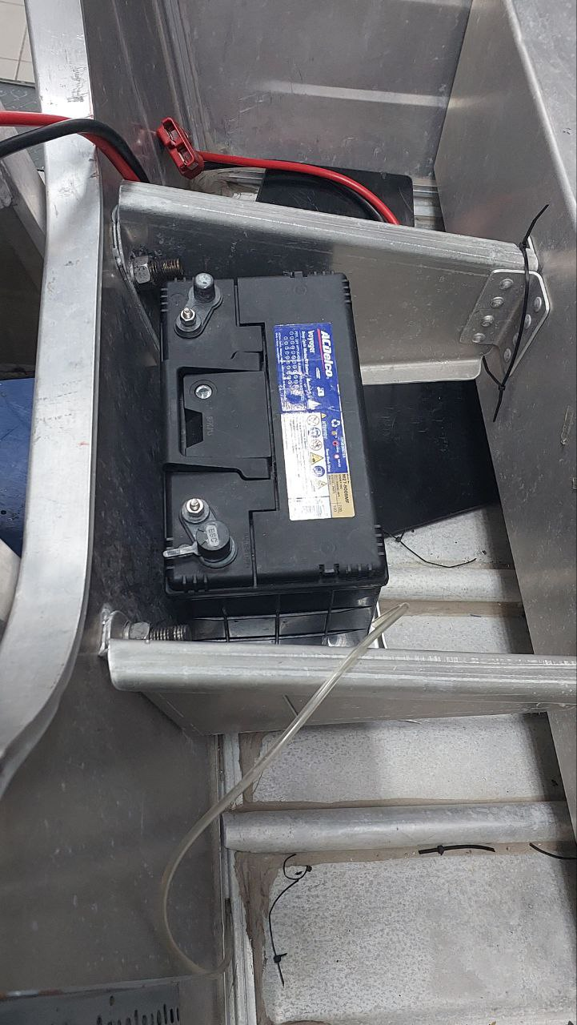
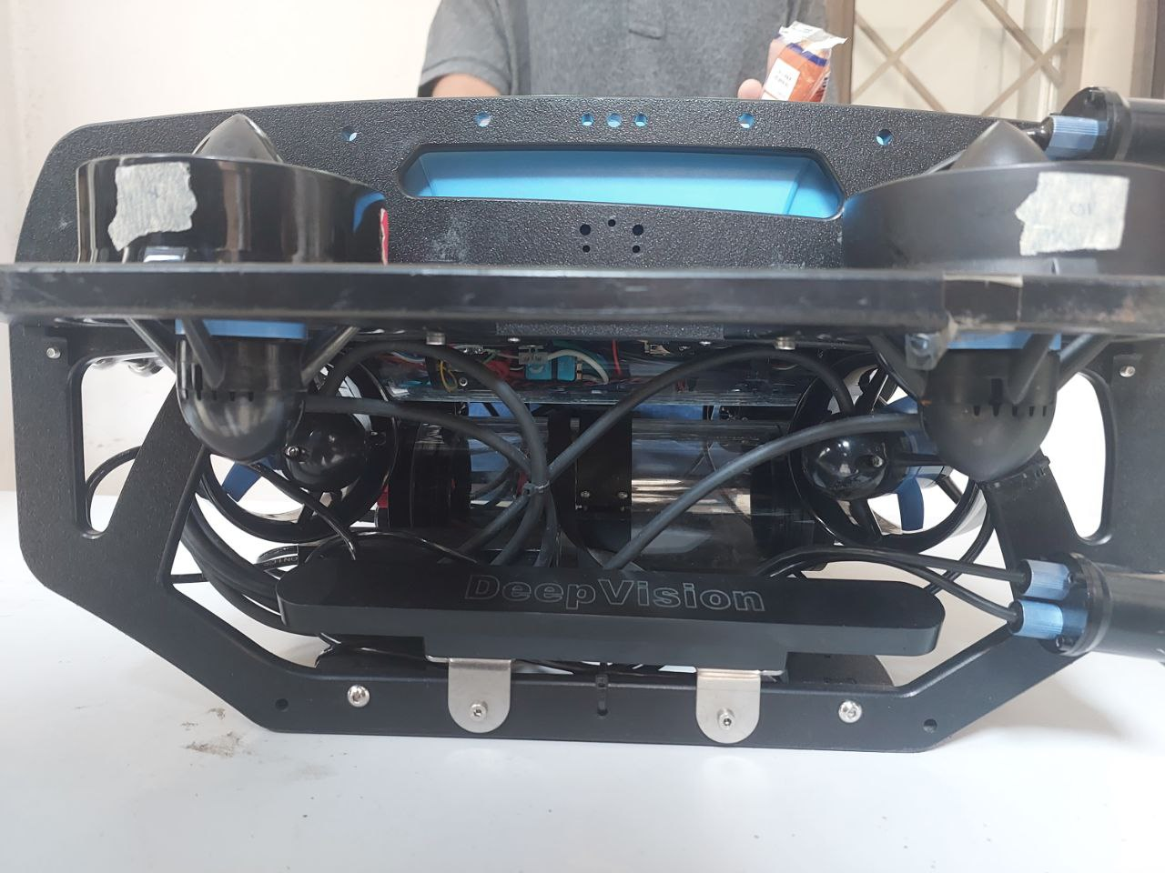
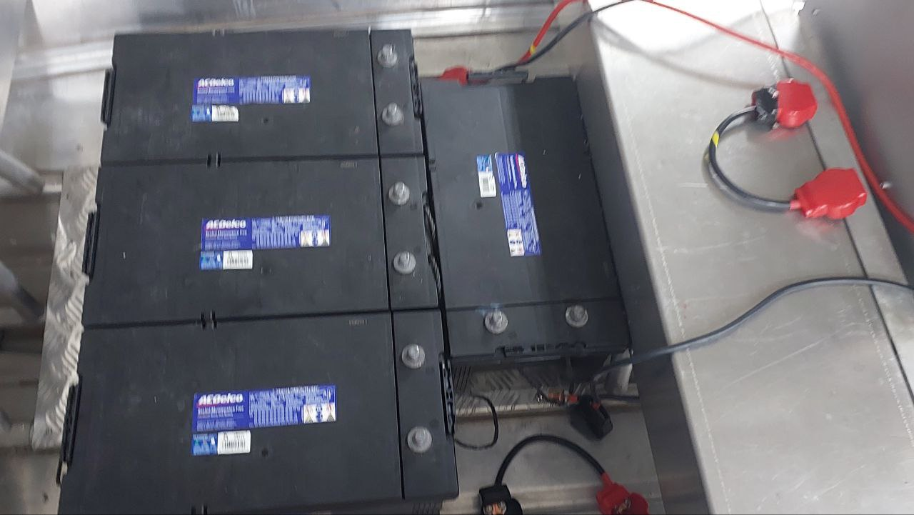
Power Transmission
Rechargeable Battery
Multiple power supply management
Single supply power usage

Slide 13


